Slide 1
Tutorial 1 Learning Topology Optimization Through Examples and Case Studies
August 18, 2019

Slide 2
Using Pareto
2019.06

Slide 3
GUI
Model/Analysis Details
Menu Bar
Workspace
Message Window

Slide 4
Setting Up a Project
Cantilever Beam Problem
Units: MKS
Material: AlloySteel
Structural Loads: 1000N
TopOpt Constraints: No Constraints
TopOpt Objective: Minimum Compliance
Goal: Optimize the topology for a volume fraction of 0.25
1000N

Slide 5
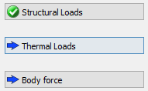
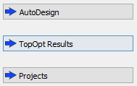
Setting Up a Project
Choose Units
Load Geometry
Define Material
Apply Loads (Structural/Thermal/Gravity)
Carry out FEA
Apply Top Opt Constraints
Topology Optimization
PostProcessing

